Slide 1
The problem
The augmented model drifts in free-run
  The ANN leaves a small non-zero-mean (constant) force on the stiffness-free X/Y axes
  Nothing in the setup constrains that constant

Slide 2
This is simultaneously an identifiability failure (the data do not constrain the direction) and a loss-blindness failure (the objective does not penalize it). The marginal integrator is the amplifier, not the cause.

Slide 3


Slide 4


Slide 5
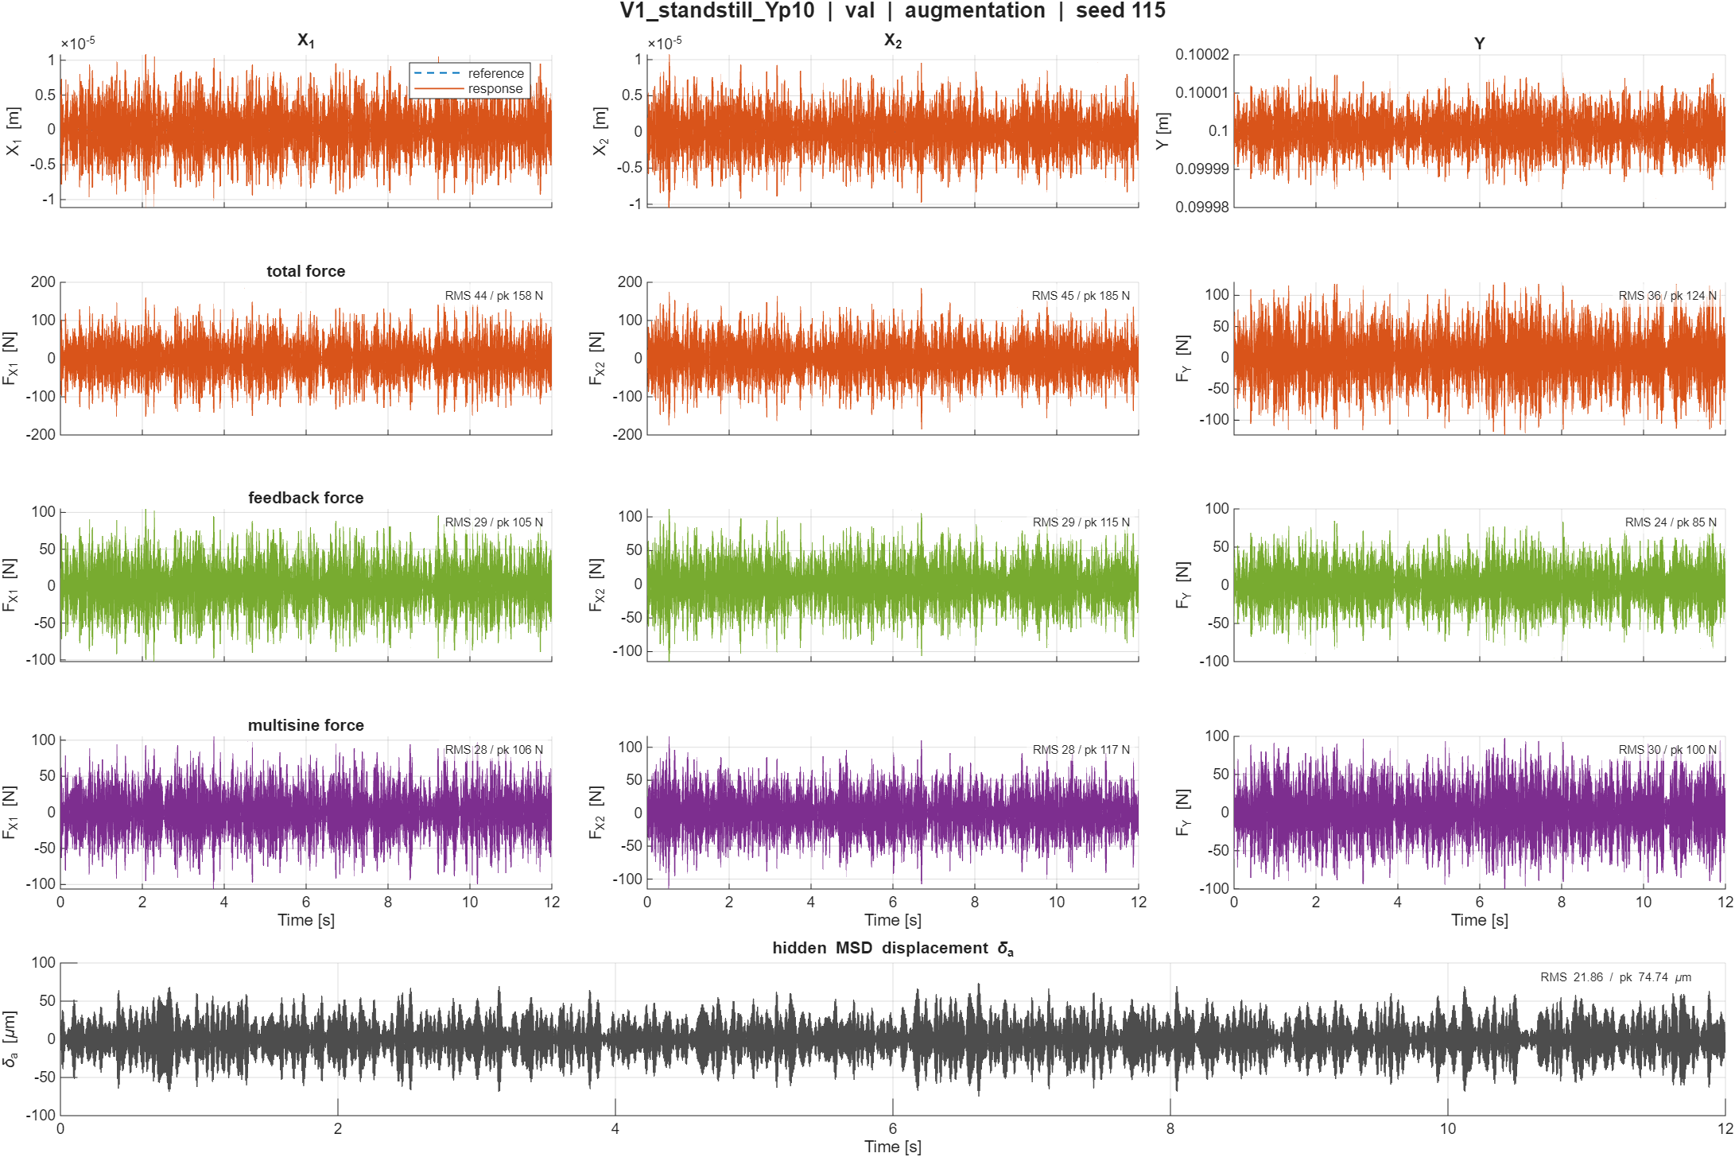

Slide 6
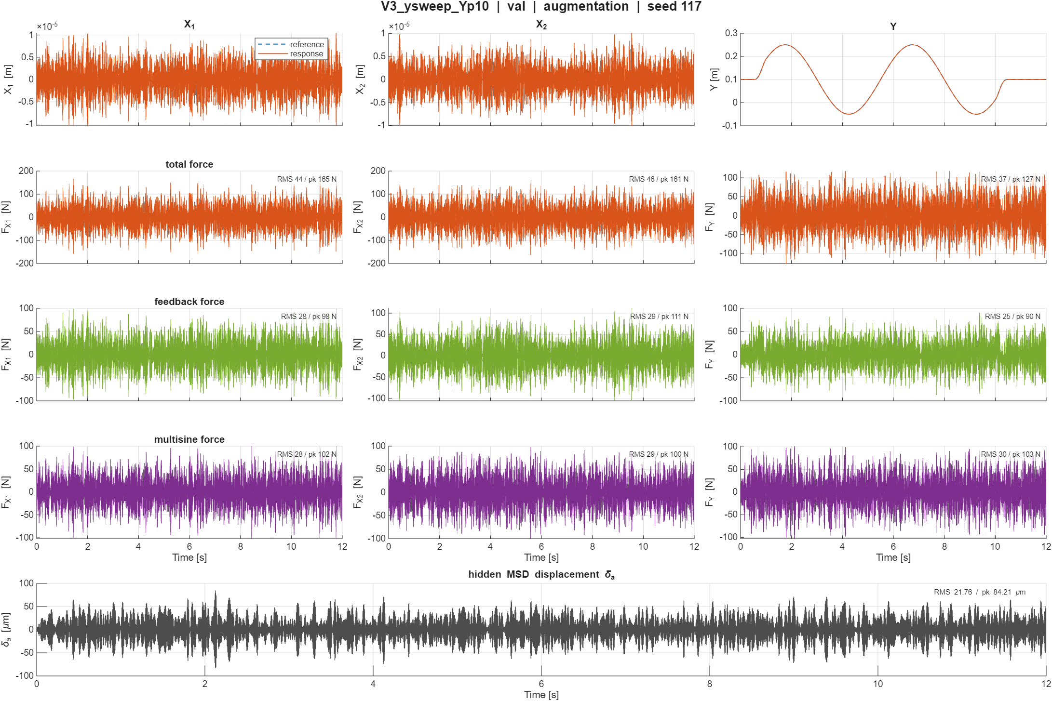

Slide 7
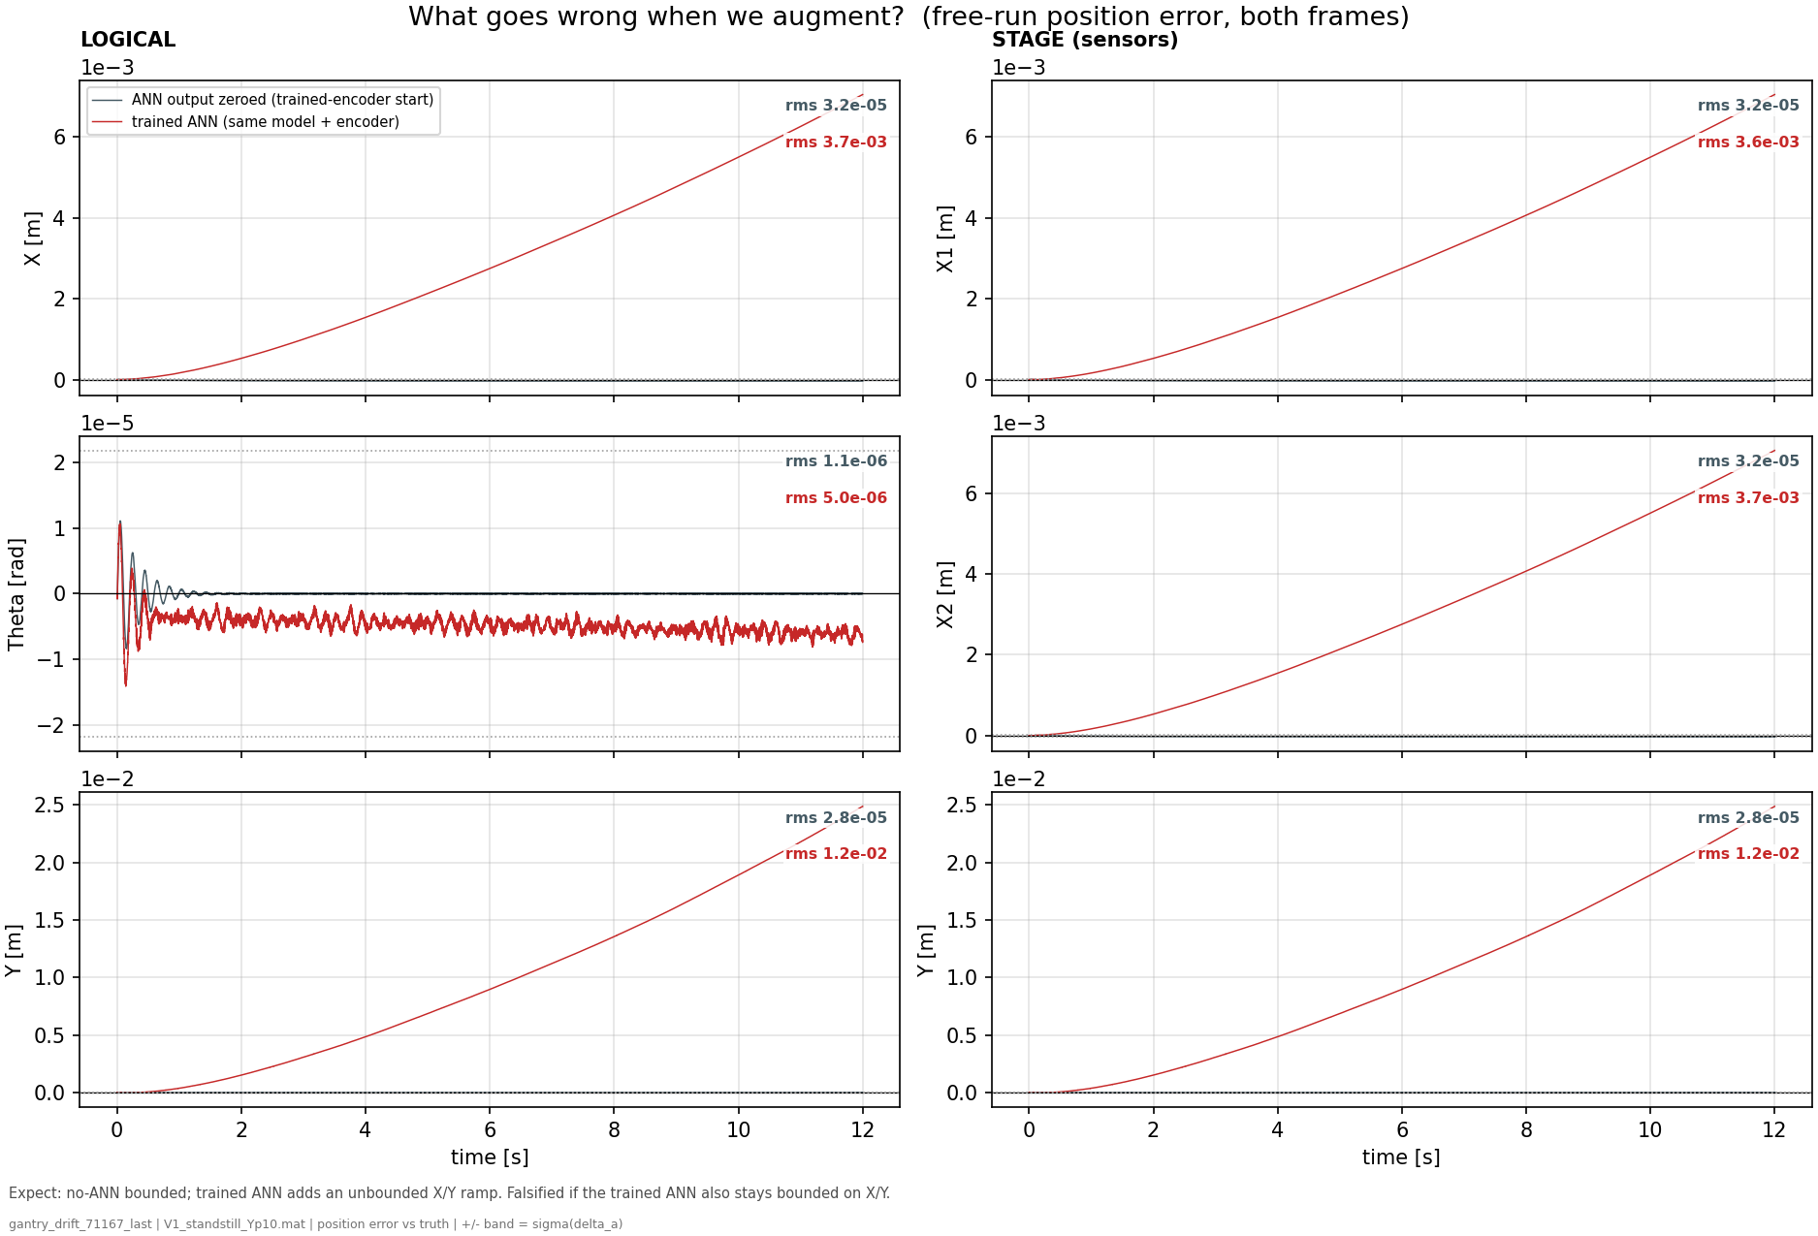
ANN adds drift
Notes:
f01 — the problem (free-run position error, trained ANN vs same model with ANN zeroed)- Shows: 12 s open-loop V1 free-run error against truth, all position channels, both frames; identical model/encoder, only the ANN output on or off.- Hypothesis: the augmentation should at worst do no harm; if it drifts, the ramp should appear on the stiffness-free axes only.- Conclusion: ANN off stays at the residual floor (rms ~3e-5 m); ANN on ramps to +7 mm on X and +25 mm on Y while sprung Theta only parks a bounded −5e-6 rad. The trained augmentation makes deployment ~400x worse, and the damage is exclusively on the K=0 axes.

Slide 8
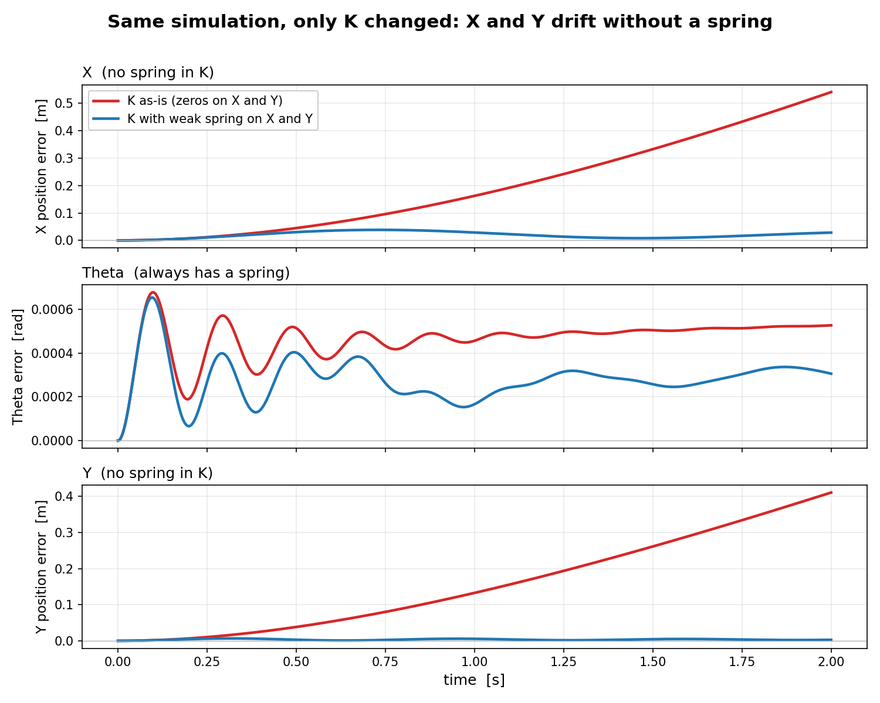
K = [0, 0, 0;
0, kb1+kb2, 0;
0, 0, 0]
Kb1+kb2 = 3975
Comparison:
K = [1000, 0, 0;
0, kb1+kb2, 0;
0, 0, 1000]
No stiffness to bound energy put into the system
Open-loop run over full trajectory: sim-RMS
→ So only initial state
Notes:
Impuls input

Slide 9
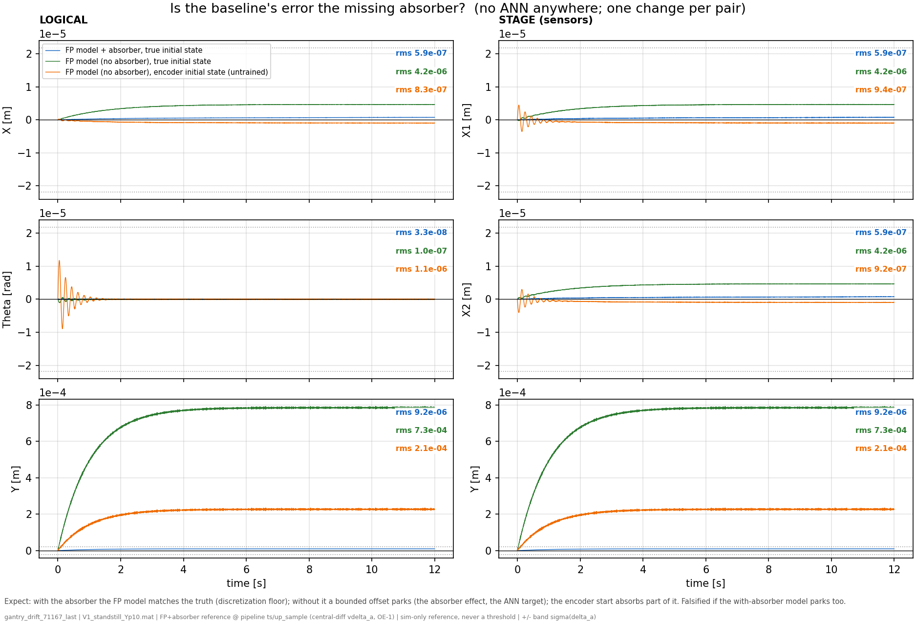
Notes:
The ideal correction (the true absorber residual) is indeed zero-mean — we verified that (f03: the missing-absorber error parks instead of ramping, so no persistent mean-force gap exists).
f03 — is the baseline's error the missing absorber? (three runs, no ANN anywhere)- Shows: FP model with the true absorber from the true initial state (blue), without it from the true state (green), without it from the untrained-encoder state (orange).- Hypothesis: if baseline physics and data are sound, the with-absorber model sits at the discretization floor, and the green-blue gap is purely the absorber's effect.- Conclusion: blue at 9.2e-6 (floor), green parks a bounded +7.9e-4 on Y — the gap is the absorber effect, i.e. the ANN's legitimate target; orange (2.1e-4) shows the encoder absorbs part of it. Crucially: nothing here ramps — the baseline does not drift on its own.

Slide 10
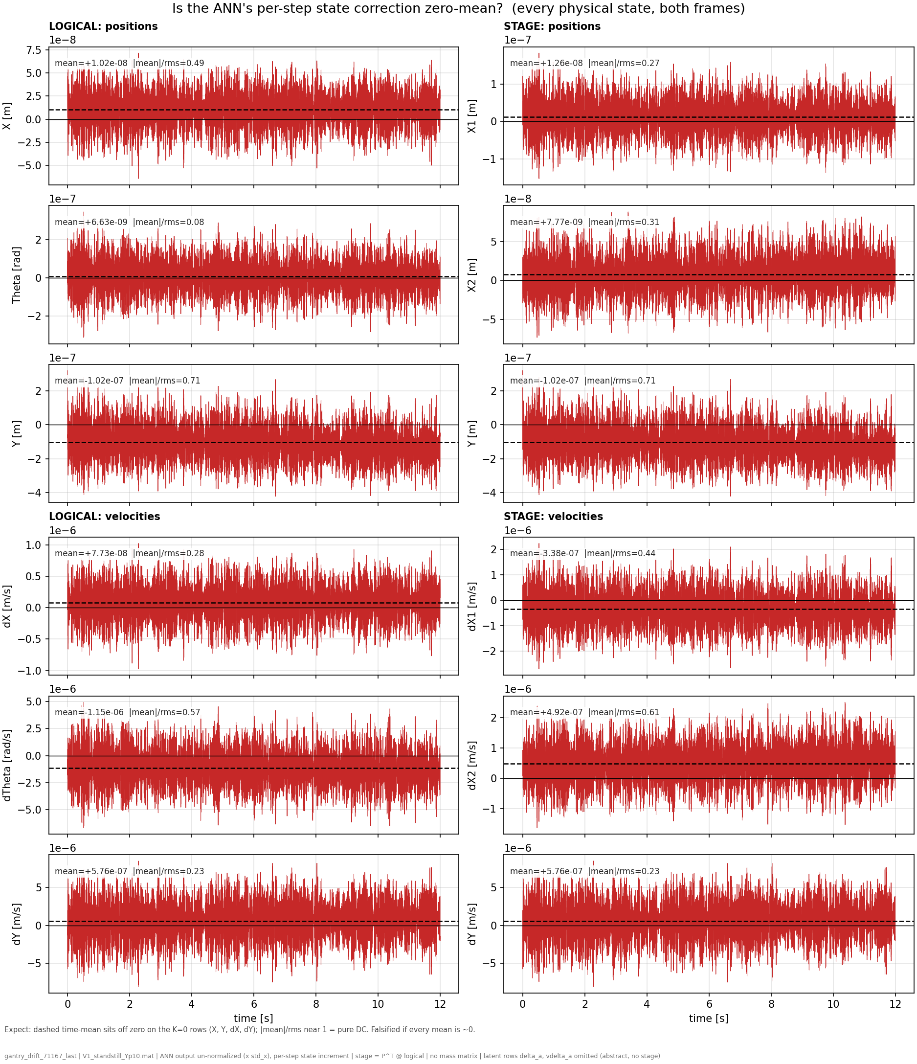
ANN correction to physical states
Notes:
f04 shows the ANN's output signal itself
$$x\left[k+1\right]=\underbrace{\text{baseline} \text{physics} \text{step}\left(x\left[k\right],u\left[k\right]\right)}\text{FP} \text{model}+\underbrace{w\left[k\right]}\text{the} \text{ANN}\text{′}\text{s} \text{correction}$$
f04 — is the correction zero-mean? (the ANN's per-step output, all states, both frames)- Shows: the raw correction the ANN adds each step, with its time-mean (dashed) and |mean|/rms (0 = zero-mean, 1 = pure constant; squared = fraction of power at DC).- Hypothesis: Jan's expectation — the correction should be zero-mean, since its target is.- Conclusion: violated. Y row mean −1.0e-7 m/step with |mean|/rms 0.71 (half the power is a constant), dY +5.8e-7 with 0.23; Theta at 0.08 shows what genuine zero-mean looks like. The constants exist, and sit on the unprotected rows.

Slide 11
Notes:
So |mean|/rms is the fraction of the signal's magnitude that is the constant part, and it lives between 0 and 1:- = 0: perfectly zero-mean. The signal is all fluctuation (what your supervisor expected).- = 1: a pure constant, no fluctuation at all.
One important nuance when explaining it: the ratio measures how constant-like the signal is, not how harmful. On the stiffness-free axes, the fluctuating part is harmless (bounded response) while the constant part integrates into an unbounded ramp. So even the dY row's modest 0.23 matters enormously: it says a small-but-persistent constant is hiding under a mostly-fluctuating signal, and the integrator selectively amplifies exactly that part, without bound, while ignoring the other 95% of the power. The harm is set by the mean's absolute size times the horizon (that's f06 and f08), while |mean|/rms establishes the existence and purity of the constant.

Slide 12
Notes:
The cleanest evidence is a comparison f04 hands us for free: the dTheta row carries one of the largest constants of all (mean −1.15e-6 rad/s per step, |mean|/rms = 0.57 — bigger in relative purity and comparable in size to the drifting rows). If constants alone caused drift, Theta should drift hardest. It doesn't: f01 shows Theta parking at a bounded −5e-6 rad while X and Y, fed smaller constants, ramp to millimeters. Same injection type, opposite fates — and the only difference between those axes is the stiffness. The spring on Theta gives the constant something to push against (equilibrium shifts, done); X and Y have nothing, so the constant is integrated forever. That is the amplifier claim demonstrated within a single figure pair, on this checkpoint.

Slide 13
Zero-mean?
Ratio = 1
  The signal is essentially constant.
Ratio ≈ 0
  The signal oscillates around zero.
Y-position: 0.71
  MSD attached to Y-payload
Compared to Theta: 0.08
  Actual zero-mean

Slide 14
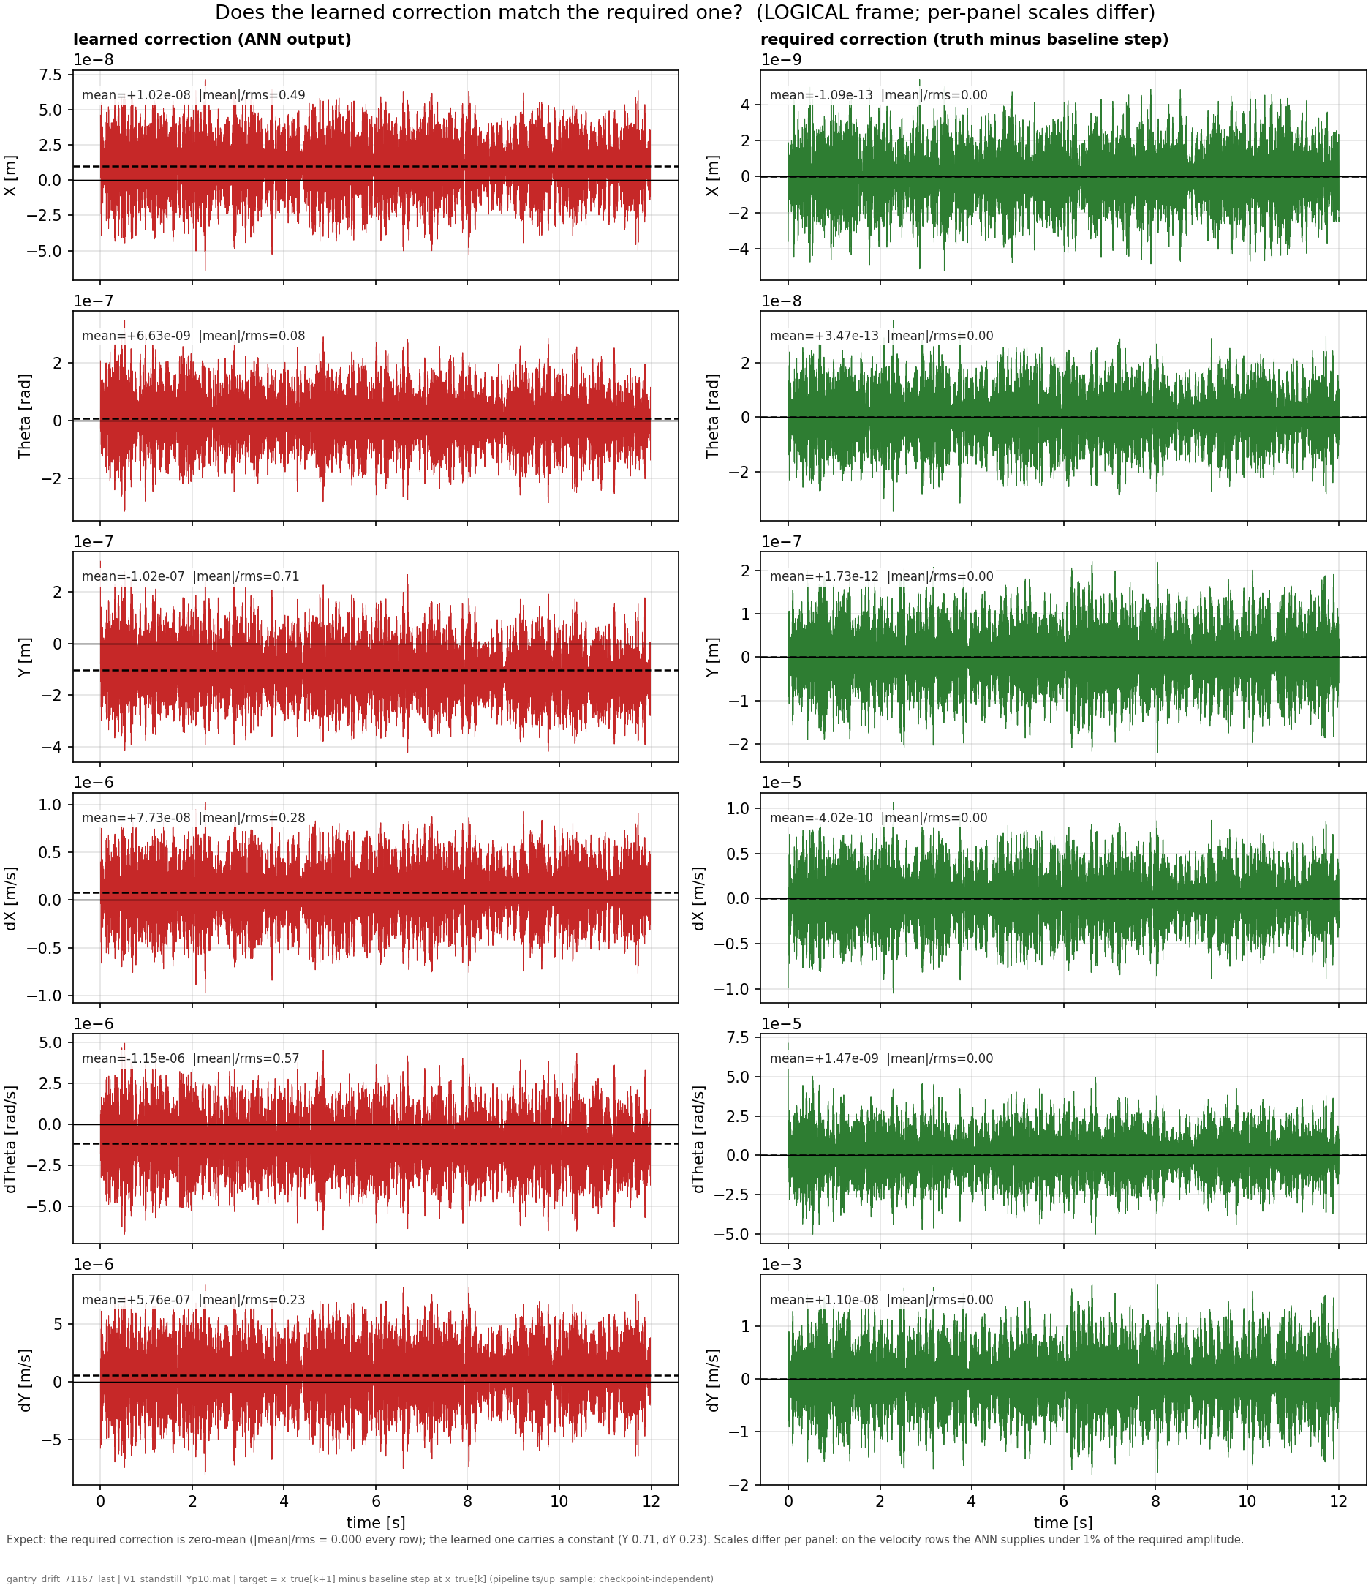
Notes:
f04b (logical) and f04c (stage), side by side per state row:- Right column (green, "required correction"): what a perfect parallel block would output at every step — measured directly from the truth as x_true[k+1] − baseline step at x_true[k], checkpoint-independent. Its dashed mean lies on zero in every panel: |mean|/rms = 0.00 across all six states, both frames. Jan's zero-mean expectation, displayed as data.- Left column (red, "learned correction"): what the trained ANN actually outputs. Same layout, and the dashed means sit visibly off zero on the K=0 rows (Y at 0.71, dY at 0.23, dTheta at 0.57).- The per-panel scales carry the second finding without saying a word: on the velocity rows the required correction is at 1e-5 to 1e-3 scale while the ANN outputs 1e-6 — the network supplies under 1% of the amplitude the absorber actually demands there, the weak-signal problem quantified row by row.Bookkeeping, all done: the target arrays are saved in f04.npz (patched today, seconds of compute), the computation is permanently in generate_data.py for all three SOURCE modes (real and reuse compute it exactly; fake synthesizes a zero-mean placeholder), and the two figures are registered in make_figures.py, so everything regenerates consistently from now on.

Slide 15
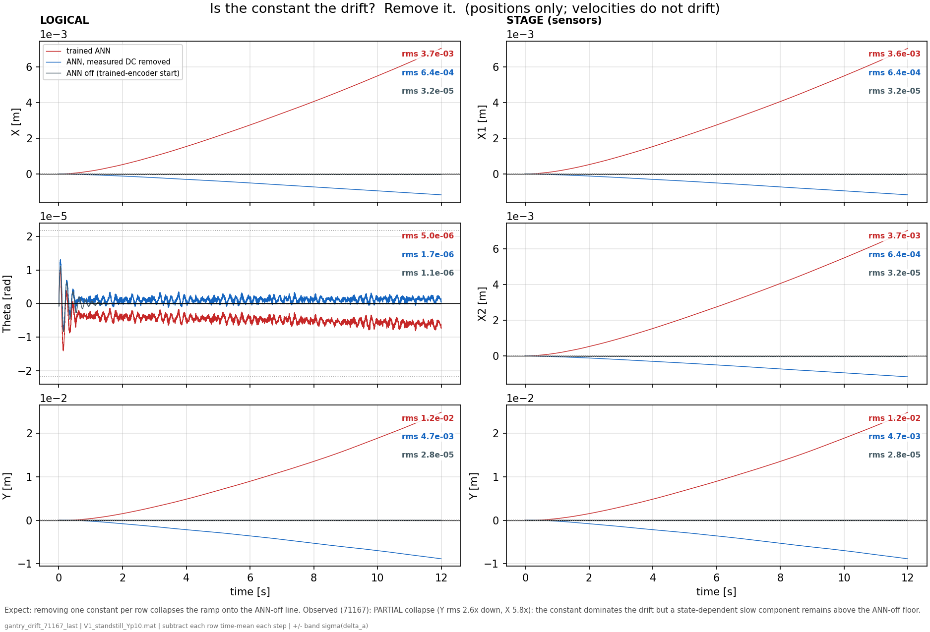
Notes:
f05 — is the constant the drift? Remove it. (full / measured-mean-subtracted / ANN off)- Shows: three re-simulations differing in one thing each: the full ANN, the same ANN with its measured per-row mean subtracted every step, and the ANN zeroed.- Hypothesis: if the constant causes the drift, subtracting one number per row collapses the ramp onto the ANN-off line.- Conclusion: the collapse is large but partial: Y rms 1.2e-2 → 4.7e-3 (2.6x), X 5.8x. The constant dominates the drift; the remainder is a slow, state-dependent offset this longer-trained checkpoint carries in addition. Causality of the mean is established by intervention, with the honest residual stated.
Pass 1 — measure it. Run the free-run with the full trained ANN and record its raw output at every step: a (T × 8) array of per-step corrections. Take the time-mean per row: one constant 8-vector, mean_w. Nothing is fitted or optimized; it is simply the average of what the ANN emitted during pass 1 (the dashed lines of f04).
Pass 2 — subtract it inside the loop. Rerun the identical free-run (same checkpoint, same encoder initial state, same input sequence), with one modification: every time the ANN is evaluated, its output is intercepted and the fixed vector is subtracted before the model uses it:$$w_{\text{used}}[k] = w_{\text{ANN}}(z[k]) - \text{mean_w}$$
Precisely, from the code: absorber_rms = data.val_x_aug[:, 0].std() — the standard deviation of the absorber's displacement δa over the V1 trajectory. That works out to ~2.19e-5 m ≈ 22 μm. It's plotted as two horizontal dotted lines at +22 μm and −22 μm (symmetric, because δa is a roughly zero-mean oscillation).What it represents: the hidden absorber (the 10%-mass MSD at 150 Hz) is exactly the unmodeled dynamics the augmentation exists to capture. Its displacement swings by ~22 μm RMS. So that band marks the scale of the thing the ANN should be learning.Why it's useful on an error plot: it turns the vertical axis into a "is this error meaningful?" yardstick:- Error inside the ±22 μm band → the residual is at absorber scale, i.e. the error is dominated by the very dynamics you're trying to model. That's the good regime.- Error outside the band → the error has grown beyond the signal itself, so it's no longer "unmodeled absorber," it's drift. On the untrained Y panel the ramp reaches ~110 μm ≈ 5× the band; on the trained figure the ANN reaches 2.6 cm ≈ 1000× the band. Both are "the error is now far bigger than the signal we care about.“
X and Y have no stiffness (K = 0). Their position is a free integrator — nothing pulls it back to a setpoint. (Physically: electric servo axes, no spring.)- Feed a constant force into such an axis: the velocity builds up to a terminal value (there's a little damping, so velocity itself stays bounded), but since that terminal velocity is nonzero and the position has no restoring stiffness, the position ramps forever. Constant force → constant drift rate → the curves you see (a short build-up, then a steady ramp to cm-scale).- Contrast with Theta (K > 0): there a constant force just produces a bounded position offset F/K — the spring balances the force and it settles. That's why Theta doesn't drift and X/Y do, under the same kind of ANN error.
So "DC-drift" = constant force × free integrator (no stiffness) = unbounded position growth. The stiffness is precisely what would stop it, and X/Y don't have it.
For your supervisor, the one-sentence version: the augmented model drifts because the ANN emits a small constant force on the stiffness-free X/Y axes, and a constant force on a free integrator integrates into unbounded position — proven by the fact that subtracting that constant removes the drift.
How it was trainedThe recipe (from the script's config):- Framework: Jan's SUBNET augmentation — the physics LPV-LFR gantry baseline in parallel with a small feedforward ANN (NX_ANN=2, 16 nodes, 2 layers, tanh) that adds corrections to the routed state rows. Encoder builds the initial state; training is windowed BPTT minimizing the nf-window simulation error with Adam.- Routing: full X+Θ+Y+absorber (0,1,2,3,4,5,6,7) — the deliverable routing, i.e. the ANN can write to the K=0 rows (that's what lets it drift).- Hyperparameters: lr = 1.49e-8, nf = 1400 (0.35 s window), 20 epochs, stride=100, validation on a cropped 8000-sample slice. Seed = cfg.seed + 3, mirroring Trial 3 of the Optuna search — the one config whose val sim-RMS actually moved past epoch 0 (6.58e-5 vs 8.01e-5), so its trained weights genuinely drift rather than staying at zero-init.- θ: nominal (joint_estimation=False) — free ANN on a correct physics baseline.- Data: the 14 noiseless augmentation simulation trajectories (standstill / ysweep / aprbs / lissajous), which contain the hidden 150 Hz MSD absorber the ANN is meant to learn.

Slide 16
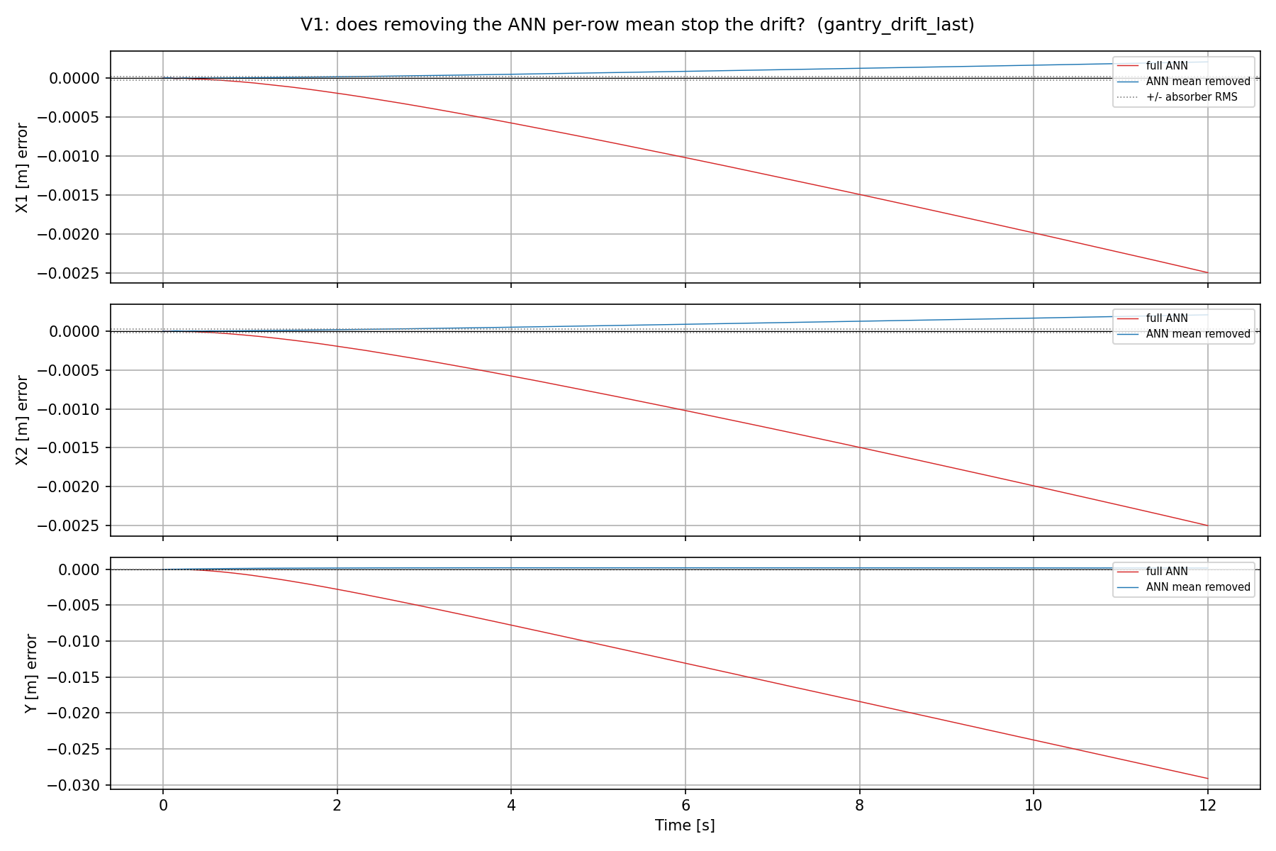
Drift with ANN
ANN creates:
  DC offset force added
Shows the error
Standstill trajectory at Y = 0.1 m with multisine 130-180hz
Notes:
Precisely, from the code: absorber_rms = data.val_x_aug[:, 0].std() — the standard deviation of the absorber's displacement δa over the V1 trajectory. That works out to ~2.19e-5 m ≈ 22 μm. It's plotted as two horizontal dotted lines at +22 μm and −22 μm (symmetric, because δa is a roughly zero-mean oscillation).What it represents: the hidden absorber (the 10%-mass MSD at 150 Hz) is exactly the unmodeled dynamics the augmentation exists to capture. Its displacement swings by ~22 μm RMS. So that band marks the scale of the thing the ANN should be learning.Why it's useful on an error plot: it turns the vertical axis into a "is this error meaningful?" yardstick:- Error inside the ±22 μm band → the residual is at absorber scale, i.e. the error is dominated by the very dynamics you're trying to model. That's the good regime.- Error outside the band → the error has grown beyond the signal itself, so it's no longer "unmodeled absorber," it's drift. On the untrained Y panel the ramp reaches ~110 μm ≈ 5× the band; on the trained figure the ANN reaches 2.6 cm ≈ 1000× the band. Both are "the error is now far bigger than the signal we care about.“
X and Y have no stiffness (K = 0). Their position is a free integrator — nothing pulls it back to a setpoint. (Physically: electric servo axes, no spring.)- Feed a constant force into such an axis: the velocity builds up to a terminal value (there's a little damping, so velocity itself stays bounded), but since that terminal velocity is nonzero and the position has no restoring stiffness, the position ramps forever. Constant force → constant drift rate → the curves you see (a short build-up, then a steady ramp to cm-scale).- Contrast with Theta (K > 0): there a constant force just produces a bounded position offset F/K — the spring balances the force and it settles. That's why Theta doesn't drift and X/Y do, under the same kind of ANN error.
So "DC-drift" = constant force × free integrator (no stiffness) = unbounded position growth. The stiffness is precisely what would stop it, and X/Y don't have it.
For your supervisor, the one-sentence version: the augmented model drifts because the ANN emits a small constant force on the stiffness-free X/Y axes, and a constant force on a free integrator integrates into unbounded position — proven by the fact that subtracting that constant removes the drift.
How it was trainedThe recipe (from the script's config):- Framework: Jan's SUBNET augmentation — the physics LPV-LFR gantry baseline in parallel with a small feedforward ANN (NX_ANN=2, 16 nodes, 2 layers, tanh) that adds corrections to the routed state rows. Encoder builds the initial state; training is windowed BPTT minimizing the nf-window simulation error with Adam.- Routing: full X+Θ+Y+absorber (0,1,2,3,4,5,6,7) — the deliverable routing, i.e. the ANN can write to the K=0 rows (that's what lets it drift).- Hyperparameters: lr = 1.49e-8, nf = 1400 (0.35 s window), 20 epochs, stride=100, validation on a cropped 8000-sample slice. Seed = cfg.seed + 3, mirroring Trial 3 of the Optuna search — the one config whose val sim-RMS actually moved past epoch 0 (6.58e-5 vs 8.01e-5), so its trained weights genuinely drift rather than staying at zero-init.- θ: nominal (joint_estimation=False) — free ANN on a correct physics baseline.- Data: the 14 noiseless augmentation simulation trajectories (standstill / ysweep / aprbs / lissajous), which contain the hidden 150 Hz MSD absorber the ANN is meant to learn.

Slide 17
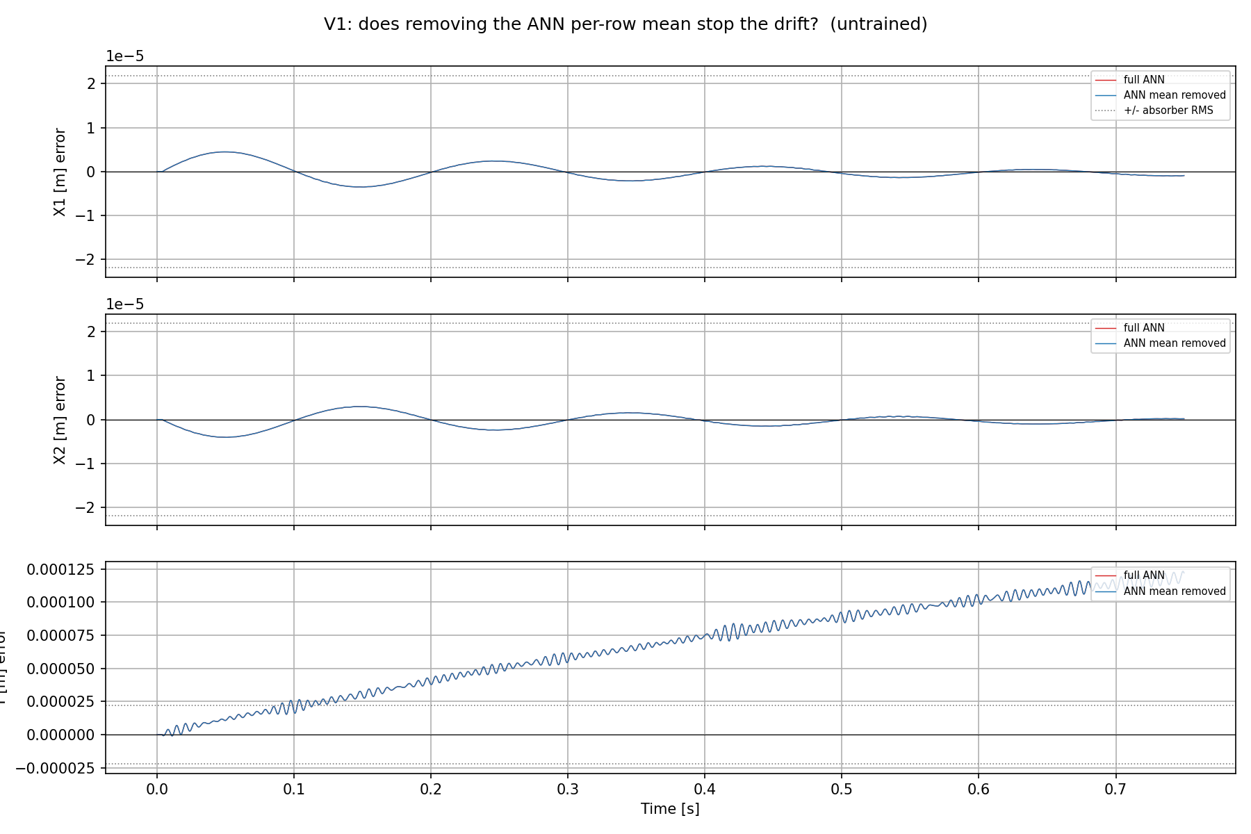
Drift with ANN
ANN at zero init:
  No DC offset force added
Shows the error
Standstill trajectory at Y = 0.1 m with multisine 130-180hz
Notes:
On the Y panel, look at the fine fast ripple riding on the ramp — that fast wiggle is the ~150 Hz content. It appears on Y specifically because the unmodeled absorber mass sits in the +Y direction (equilibrium offset L0 in +Y), so its mismatch imprints mainly on Y. Over 0.75 s that's ~110 cycles, so it reads as a dense ripple, not clean sinusoids.
"does removing the ANN's constant force stop the drift?" Untrained → the mean is ~0, so subtracting it changes nothing → it lies exactly on top of the red line (that overlap is the whole point of the control).
- "full ANN" (red): the free-run error using the ANN's complete output. Here (untrained) the ANN is zero-init, so this is effectively baseline + zero-ANN = the baseline free-run error.- "ANN mean removed" (blue): the counterfactual — the same free-run but with the ANN's per-row time-average (its DC/constant component) subtracted. This is the d6 test: "does removing the ANN's constant force stop the drift?" Untrained → the mean is ~0, so subtracting it changes nothing → it lies exactly on top of the red line (that overlap is the whole point of the control).- "+/- absorber RMS" (dotted horizontal lines at ±2.19e-5 m): the RMS of the absorber displacement — the scale of the signal the ANN is supposed to learn. It's a materiality yardstick: error inside the band is absorber-scale; the Y ramp climbing past it means the drift already exceeds the signal you care about.

Slide 18
    Nothing in the setup constrains that constant: the excitation does not excite it and the 0.1 s training window cannot see its free-run consequence. So the training objective is blind to the error that dominates deployment, and the augmentation is unlearnable as set up.

Slide 19
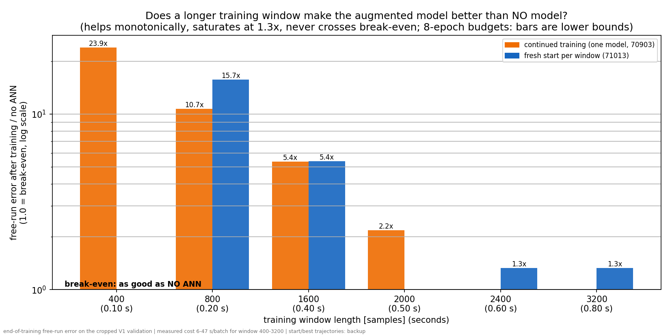

Slide 20
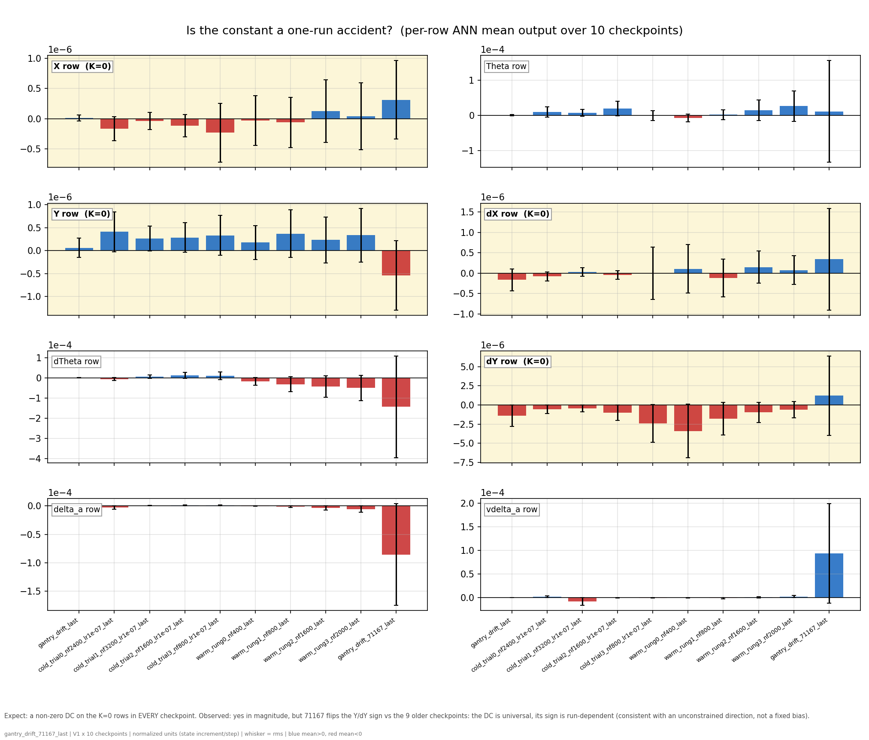
Notes:
f07 — is it a one-run accident? (per-row output mean across 10 checkpoints)- Shows: the DC (bar) and rms (whisker) of each ANN row for ten independently trained checkpoints spanning the nf and lr sweeps, cold and warm starts, plus 71167.- Hypothesis: one bad run → the other nine sit at zero; a physically demanded constant → same sign and size everywhere.- Conclusion: neither. All ten park a constant on the K=0 rows, but 71167 flips the Y/dY signs vs the other nine: universal in existence, arbitrary in value — the signature of an unconstrained direction, and direct evidence that the nf/lr tuning already performed never removed it.
f07 answers the robustness question a skeptical reader asks after f04: "you showed me one trained network with a non-zero mean — is that just one bad run?"What is plottedEight panels, one per ANN output row (X, Theta, Y, dX, dTheta, dY, and the two absorber latents), with the stiffness-free rows highlighted yellow. Within each panel there are ten bars = ten independently trained checkpoints:- the old rough drift checkpoint (gantry_drift_last),- four cold-start nf-sweep trials (nf = 800 to 3200, lr = 1e-7),- four warm-start curriculum rungs (nf = 400 to 2000),- and run 71167 (the current deck checkpoint), appended as the tenth.For each checkpoint, the ANN's output was recorded over a V1 free-run, and the bar shows the time-mean of that row's output (the DC, in normalized state-increment-per-step units); the whisker shows the rms of the same signal, i.e. the total signal size the mean should be judged against. Blue means positive mean, red negative. Bar comparable to whisker = nearly pure constant; small bar under a big whisker = a constant buried in fluctuation.How to read itTwo comparisons per panel: across bars (does every independently trained network park a constant on this row, and with what sign?) and bar vs whisker (how constant-like is each one?). Across panels: do the constants concentrate on the yellow K=0 rows?What it shows, honestly stated1. The constant is universal in existence. All ten checkpoints — different window lengths, learning-rate regimes, cold and warm starts — carry non-zero means on the K=0 rows. No amount of nf or lr tuning produced a zero-mean network, which is f07's direct contribution to the "tuning doesn't fix this" argument: the checkpoints are the tuning sweep.2. The constant is arbitrary in value and sign. This is the updated conclusion forced by 71167: the nine older checkpoints all parked a positive Y-row mean and negative dY-row mean, and 71167 flips both. The caption now says this explicitly. The sign scatter is not a weakness of the story — it is the strongest evidence for the mechanism: a constant demanded by physics would reproduce with the same sign and size in every run; a constant living in an unconstrained direction lands wherever each run's optimization noise pushes it. Ten runs, one shared property (a leftover DC), no shared value.3. 71167 is also visibly the outlier in magnitude on several rows (dTheta, delta_a, vdelta_a — largest bars and whiskers), consistent with it being the longest-trained member: more optimization steps in a flat direction means more accumulated wander.One provenance note to be transparent about in the meeting: the nine older members were measured over short (2 s) free-runs from the existing checkpoint bank, while 71167's bar is measured over the full 12 s of this generation — d15 established the DC is stationary over the run, so the horizons are comparable, but it should be said rather than discovered.Summary: f07 measures the per-row output mean of ten independently trained checkpoints spanning the nf/lr/init axes; every one of them parks a constant on the stiffness-free rows, but the sign and size differ per run (71167 flips Y/dY versus all nine older ones). Together that rules out both "one bad run" and "a fixed physical bias the ANN correctly learned," leaving exactly the deck's diagnosis: an unconstrained direction that every training run fills with its own arbitrary leftover.

Slide 21
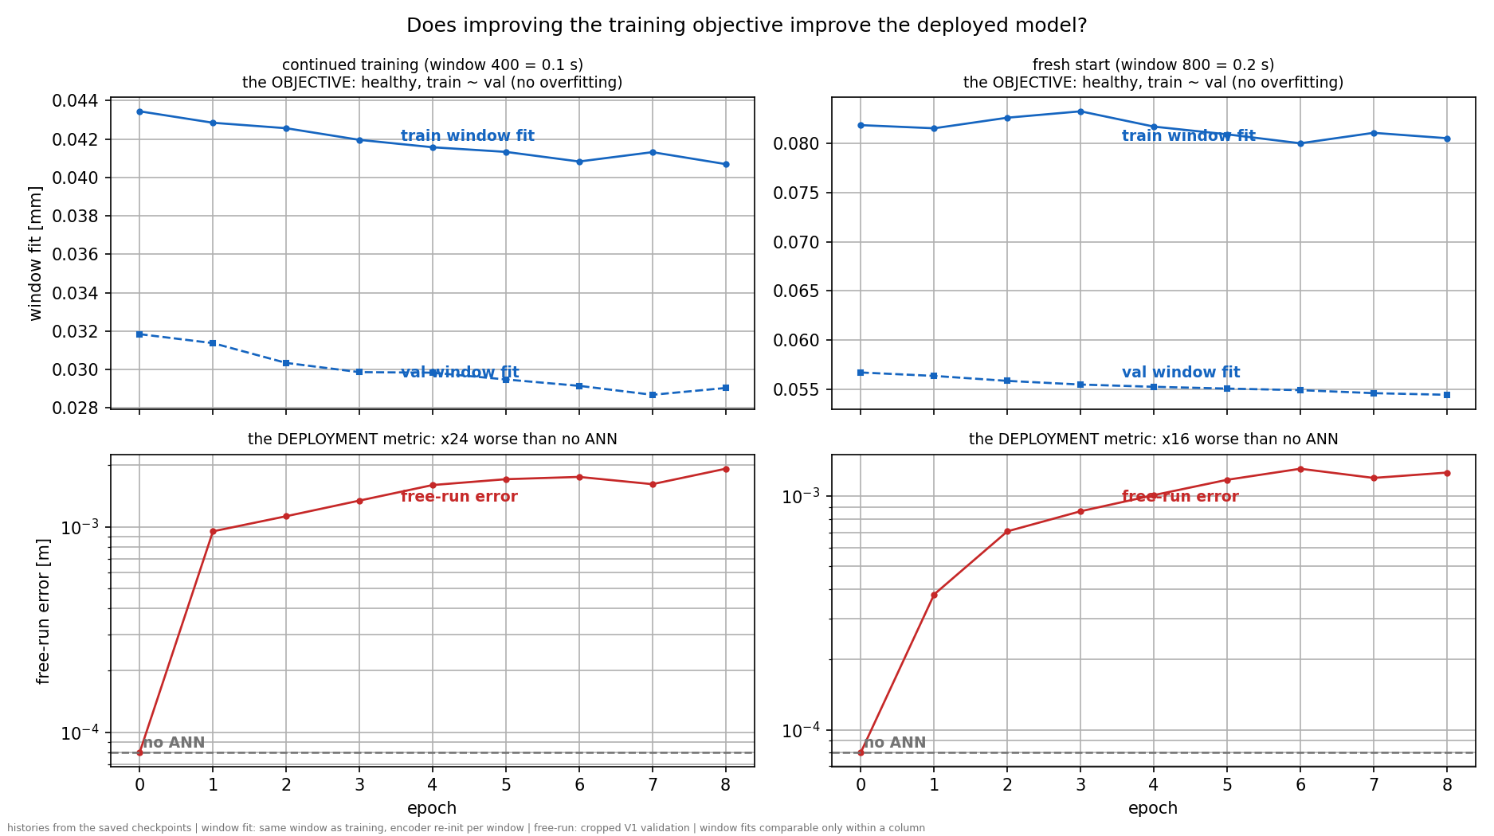

Slide 22
Take the derivative of the trained-ANN free-run
Position-error is the red line
Answer: is it an energy problem?

Slide 23
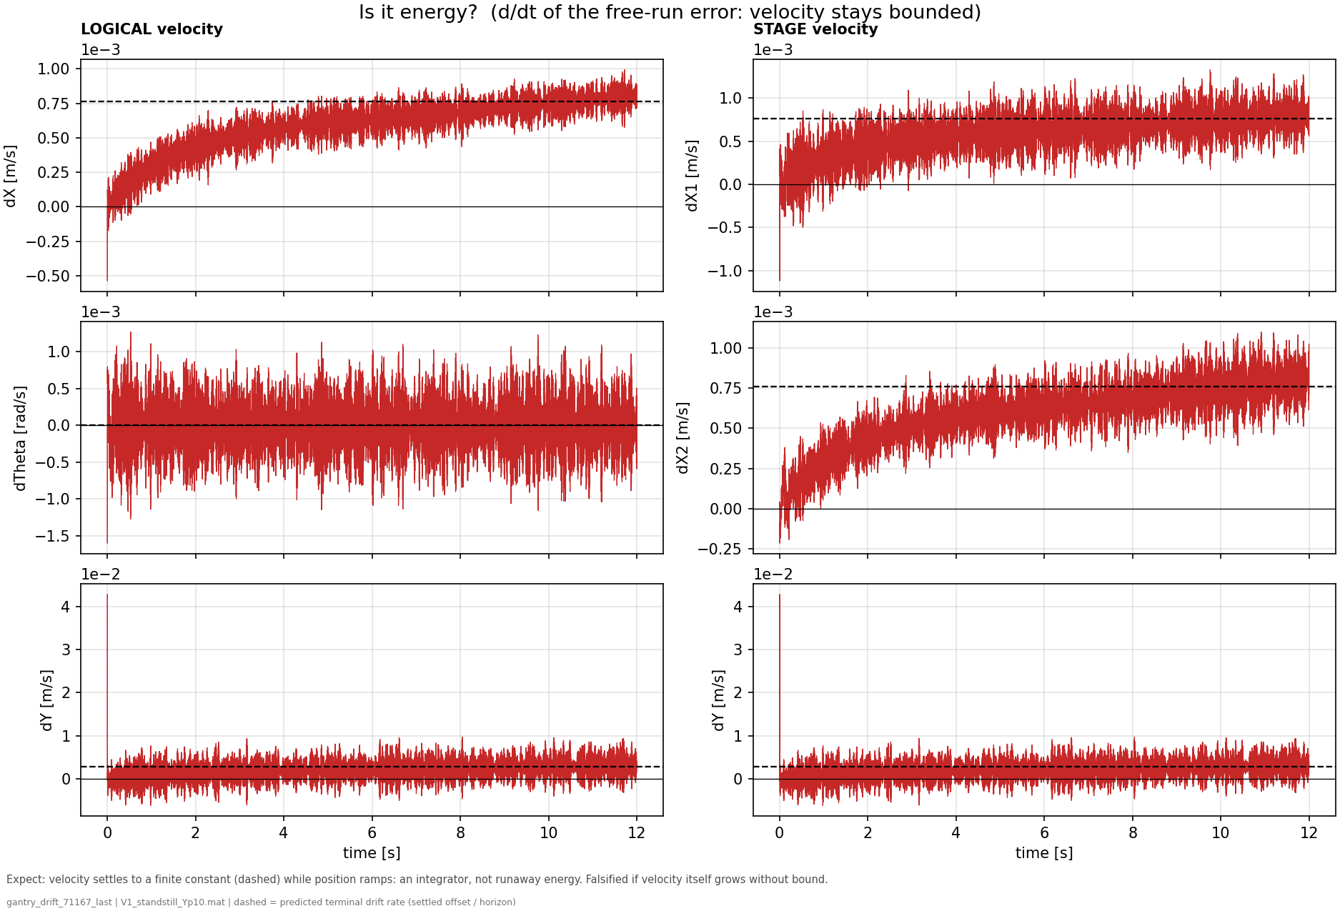
Conclusion:
Not an energy problem velocity seems to settle
Notes:
the trained-ANN free-run position error from f01 (the red drifting curves) and differentiate it in time
At t = 0 the free-run starts from the encoder's estimated state, not the true one. The estimate is good but not exact, and its velocity components are the weakest part:
f08 — is it energy? (d/dt of the drifting run's error)- Shows: the error velocity of the same trained-ANN free-run as f01, with the settled terminal rate dashed. (t = 0 spike = the encoder's initial velocity estimate error decaying with each axis's time constant — an IC transient, not drift.)- Hypothesis: if the drift were energy accumulation/instability, velocity (and kinetic energy) would grow without bound.- Conclusion: every velocity saturates at a finite terminal value while position ramps — the exact signature of a constant force balanced by damping. Energy is bounded (injection = dissipation); Jan's "no energy drift" intuition is confirmed, and an energy constraint targets nothing that is failing.

Slide 24
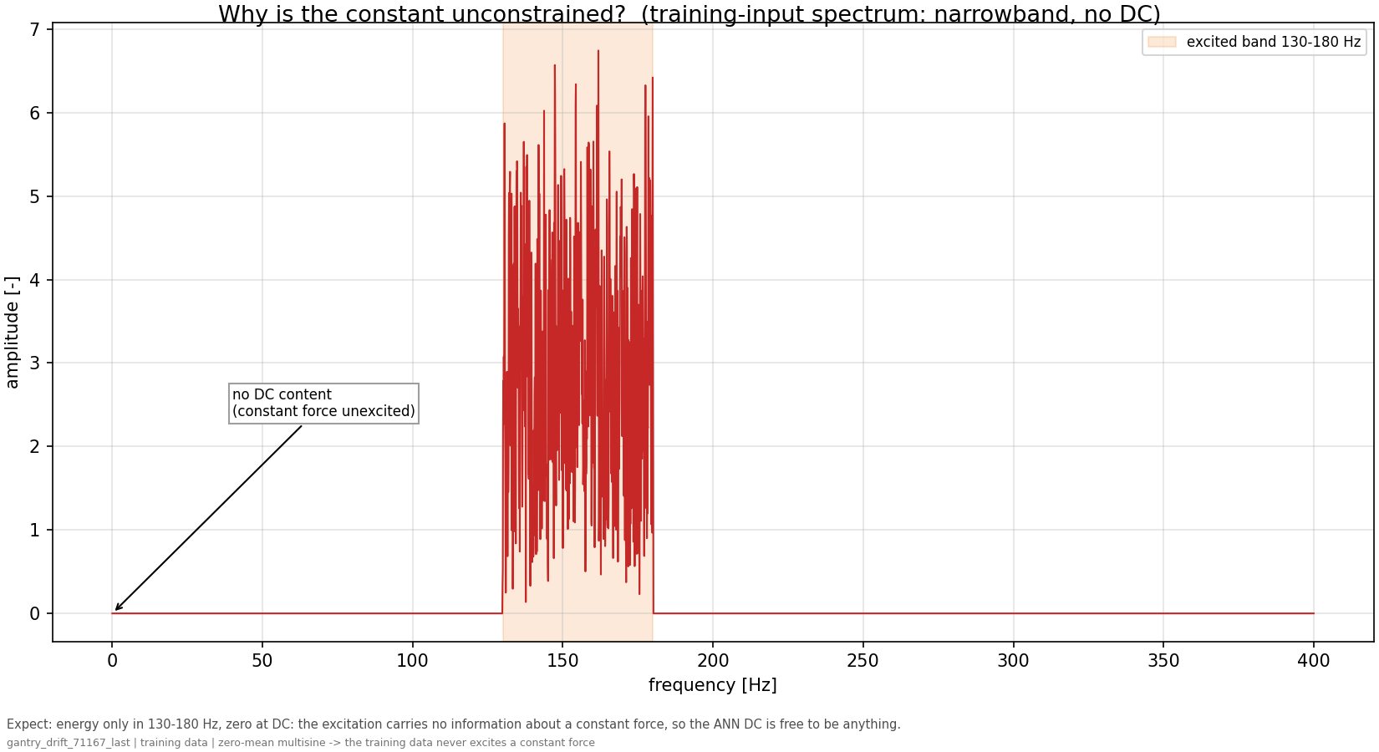
Notes:
f10 — why is the constant unconstrained? (training input spectrum)- Shows: the excitation's amplitude spectrum: energy strictly inside 130-180 Hz, exactly zero at 0 Hz.- Hypothesis: to identify a constant (a 0 Hz component), the data must contain energy at 0 Hz for the model to match or mismatch.- Conclusion: they contain none, so the correction's mean is a direction the fit never compares against anything — a free parameter. Combined with f09 (the loss can't see its consequence either), the constant is doubly unconstrained: unexcited and unpriced.

Slide 25
Solution?
Steer training so that the force added to the stiffness-free X and Y axes has no net average.
  Not a hard constraint: only discourage where the data gives no reason for one
  Problem: real system will have friction with nonzero average
    Therefore: steer only in the direction the data cannot inform

Slide 26
Configuration:
MODE: augmentation
ENCODER_INIT: linear_map
ANN_ACTIVATION: tanh
JOINT_ESTIM: False
SNR (noise): None (noiseless)
save_dir: /dataB1/dirk_van_den_berg/repos/LPV-LFR-Baseline-Augmentation/simulations/gantry_subnet/augmentation_linear_map/71167
NF_SECONDS: 0.1
na_nb (samples): 17 (4.25 ms)
Sampling rate: 4000 Hz (D=5)
Dtype: float32
Default hyperparameters (may be overridden by checkpoint):
NX_ANN: 2
n_nodes_per_layer: 16
n_hidden_layers: 2
up_sample: 1
nf: 400
na_nb: 17
batch_size: 256
lr: 1e-07
epochs: 20

Slide 27
NEW SLIDES

Slide 28
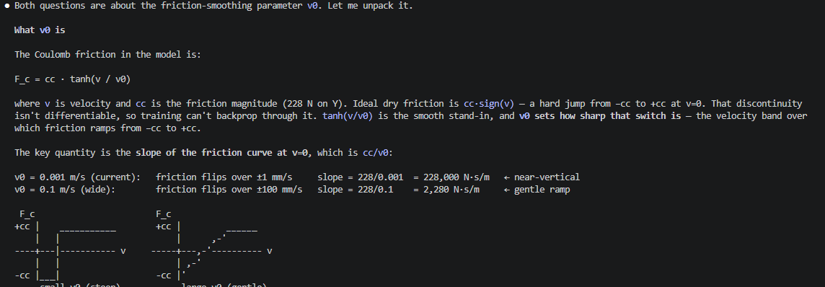
Tanh smoothing for coulomb friction

Slide 29
This is a strong thesis result on its own: the closed-loop test reveals that the ~300 Hz X structural mode is absent from the recovered model — a specific target for the augmentation to capture, and the reason CL cannot currently validate the model.

Slide 30
These aren't in tension because the DC does not come from the physics. It comes from the estimation setup. The optimizer is never asked to match the zero-mean true correction directly — it minimizes a windowed free-run loss on K=0 integrator states,

Slide 31
How can you say the system is actually zero mean, if i look at the correction the ANN should actually learn it's also zero mean. but as far as i know you can correct me, what the ANN learns is non zero mean.

Slide 32
Optimizer
Adam vs SGD

Slide 33
The chain of reasoning:- Our confirmed result: Adam amplifies a tiny, seed-consistent gradient in the DC direction (stage 2). Open question: why does that tiny gradient exist at all?- The report's hypothesis: it's truncated-BPTT bias, and that bias is non-decaying specifically because the X/Y axes are marginally stable — poles exactly at z=1 (λ→1). For a contractive mode (λ<1) the bias would decay; for a pure integrator it never does.- The pole-perturbation tests that hypothesis directly: add a small stiffness so the X/Y poles move from z=1 to z=1−δ (λ<1). If the DC then shrinks, marginal stability (λ=1) is confirmed as the source. If the DC is unchanged, the source is something else.

Slide 34
Updated figure
Laten zien hoe coulomb nu terug komt in de formules voorheen en nu
Zero mean problem uitleggen omdat alle initializatie around a zero mean is.
  Offset msd zou dit kunnen veroorzaken
  Laten zien dat het system daadwerkelijk zero mean is
  De juiste correctie is ook zero-mean
    Wat is dan het problem?

